Slide 1
Abstract Factory
Nancy Morris

Slide 2
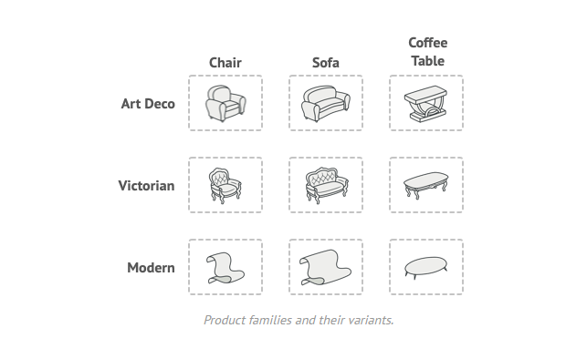
Problem

Slide 3
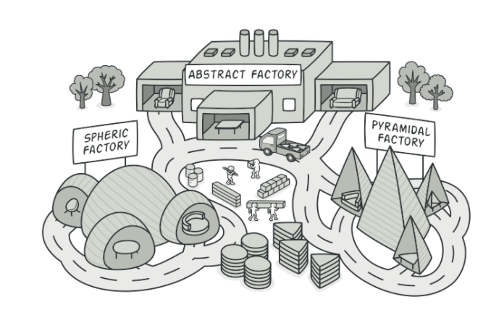
Abstract Factory

Slide 4
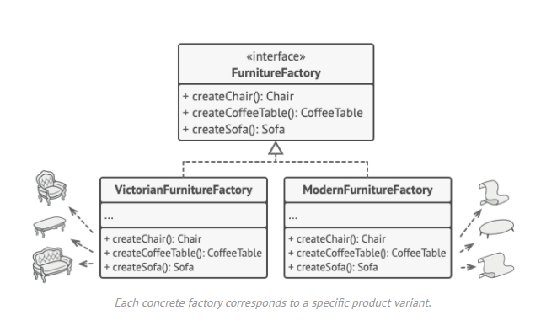
Solution

